Slide 1

La’ Fromagerie

Slide 2

Mission statement: To bring the choicest of cheeses to anyone’s doorstep

Slide 3
The problem
To create an online FMCG store that specializes in the sale of various varieties of cheeses using MERN stack tools

Slide 4
Technical Milestones
September 2021
December 2021
Backend + API + Database connection completed
Wireframe diagram completed
Sept | Oct | Nov | Dec
Frontend complete
Website presentation

Slide 5
How it runs
Stage 1
Stage 2
Stage 3
The homepage takes you straight to the product page components generated by input from our database hosted on MongoDB, forwarded to the component using ExpressJS methods to get the data from the API written using NodeJS. No distractions.
Our login option allows users to create their own accounts on the website, upon which a separate document on the database is updated with their information. Logins are cross verified with this information for clearance
The various tabs on the home bar link to different pages using URL routing from ReactJS

Slide 6

Next up : About the business

Slide 7
Business model
Dairy farm processing plant
Warehouse (where the cheese sits, awaiting your order)
Cooks / Cheese enthusiasts
Founded in 2021, La’ Cheezus deals with the import and sale of niche varieties of cheeses that you wouldn’t exactly find with a single google search
Like most online stores, our business operates on a B2C basis. We do this to ensure that the relatively fast expiring cheeses reach their intended users on time, as fresh as possible

Slide 8
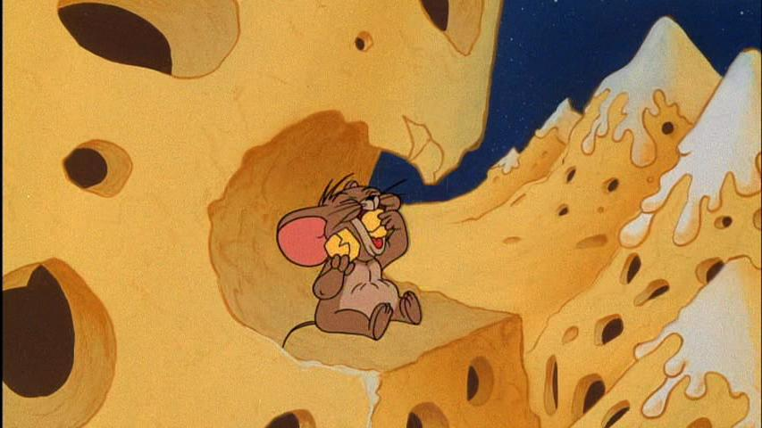
Our selection currently includes some niche varieties including but not limited to original Parmesano Reggiano, Gouda and classic aged French blue cheeses among others.
Our warehouses are currently at 60% capacity. Order Now before it goes out of stock!

